Slide 1
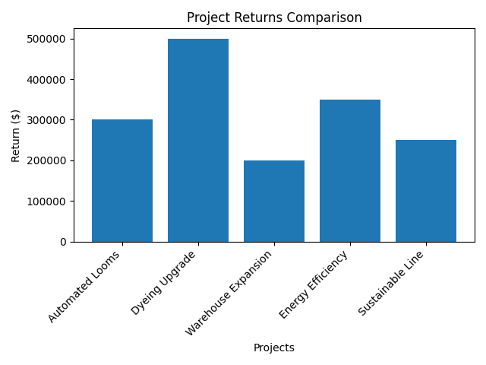
Fund 4 Projects to Maximize Return
Fund Dyeing, Looms, Warehouse, Sustainable Line
Generates ~$1.25M total return
Fits within budget and labor limits
Best overall investment mix

Slide 2
VP Faces Limited Budget and Competing Projects
Textile company decision
$1M budget and limited labor
Multiple project options
Goal: maximize return

Slide 3
Model Identifies Best Combination
Chooses which projects to fund
Maximizes return
Respects constraints
Includes dependencies

Slide 4
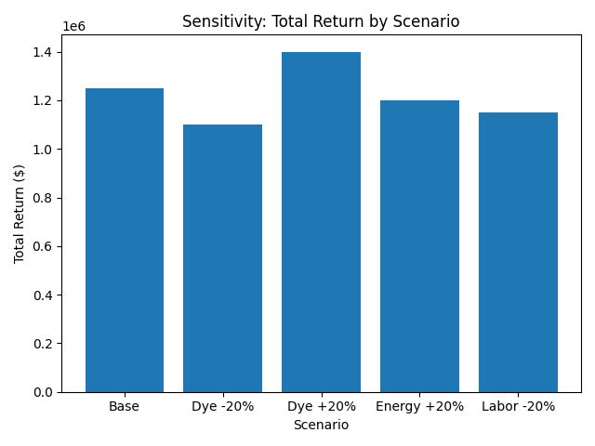
Returns Depend on Key Assumptions
Dyeing return most critical
Energy cost moderate impact
Labor limits flexibility
Mostly stable results

Slide 5
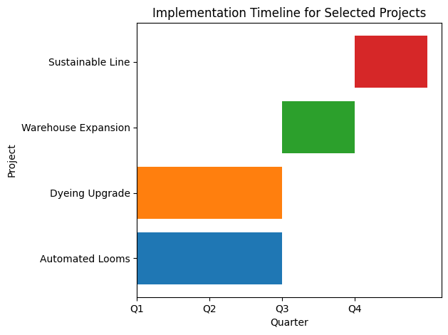
Projects Rolled Out Over Time
Q1–Q2: Looms + Dyeing
Q3: Warehouse
Q4: Sustainable
Avoids bottlenecks
Enables early gains

Slide 6
Model Has Real-World Limits
Automation slows over time
Returns depend on demand
Markets can saturate
Use as directional guide

Slide 7
Validate Before Acting
Proceed with 4 projects
Confirm dyeing returns
Check labor availability
Next: operations review

